Slide 1


SEVBioCon: SouthEast Vegetable Biological Control working group

Slide 2
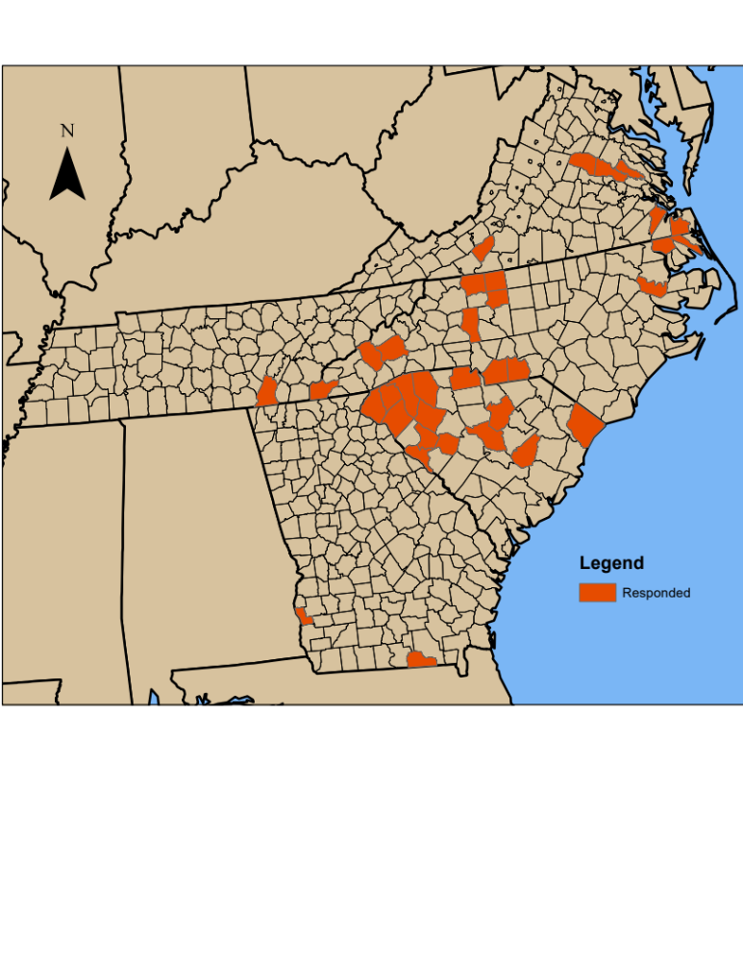
Survey received responses from over 39 counties

