Slide 1
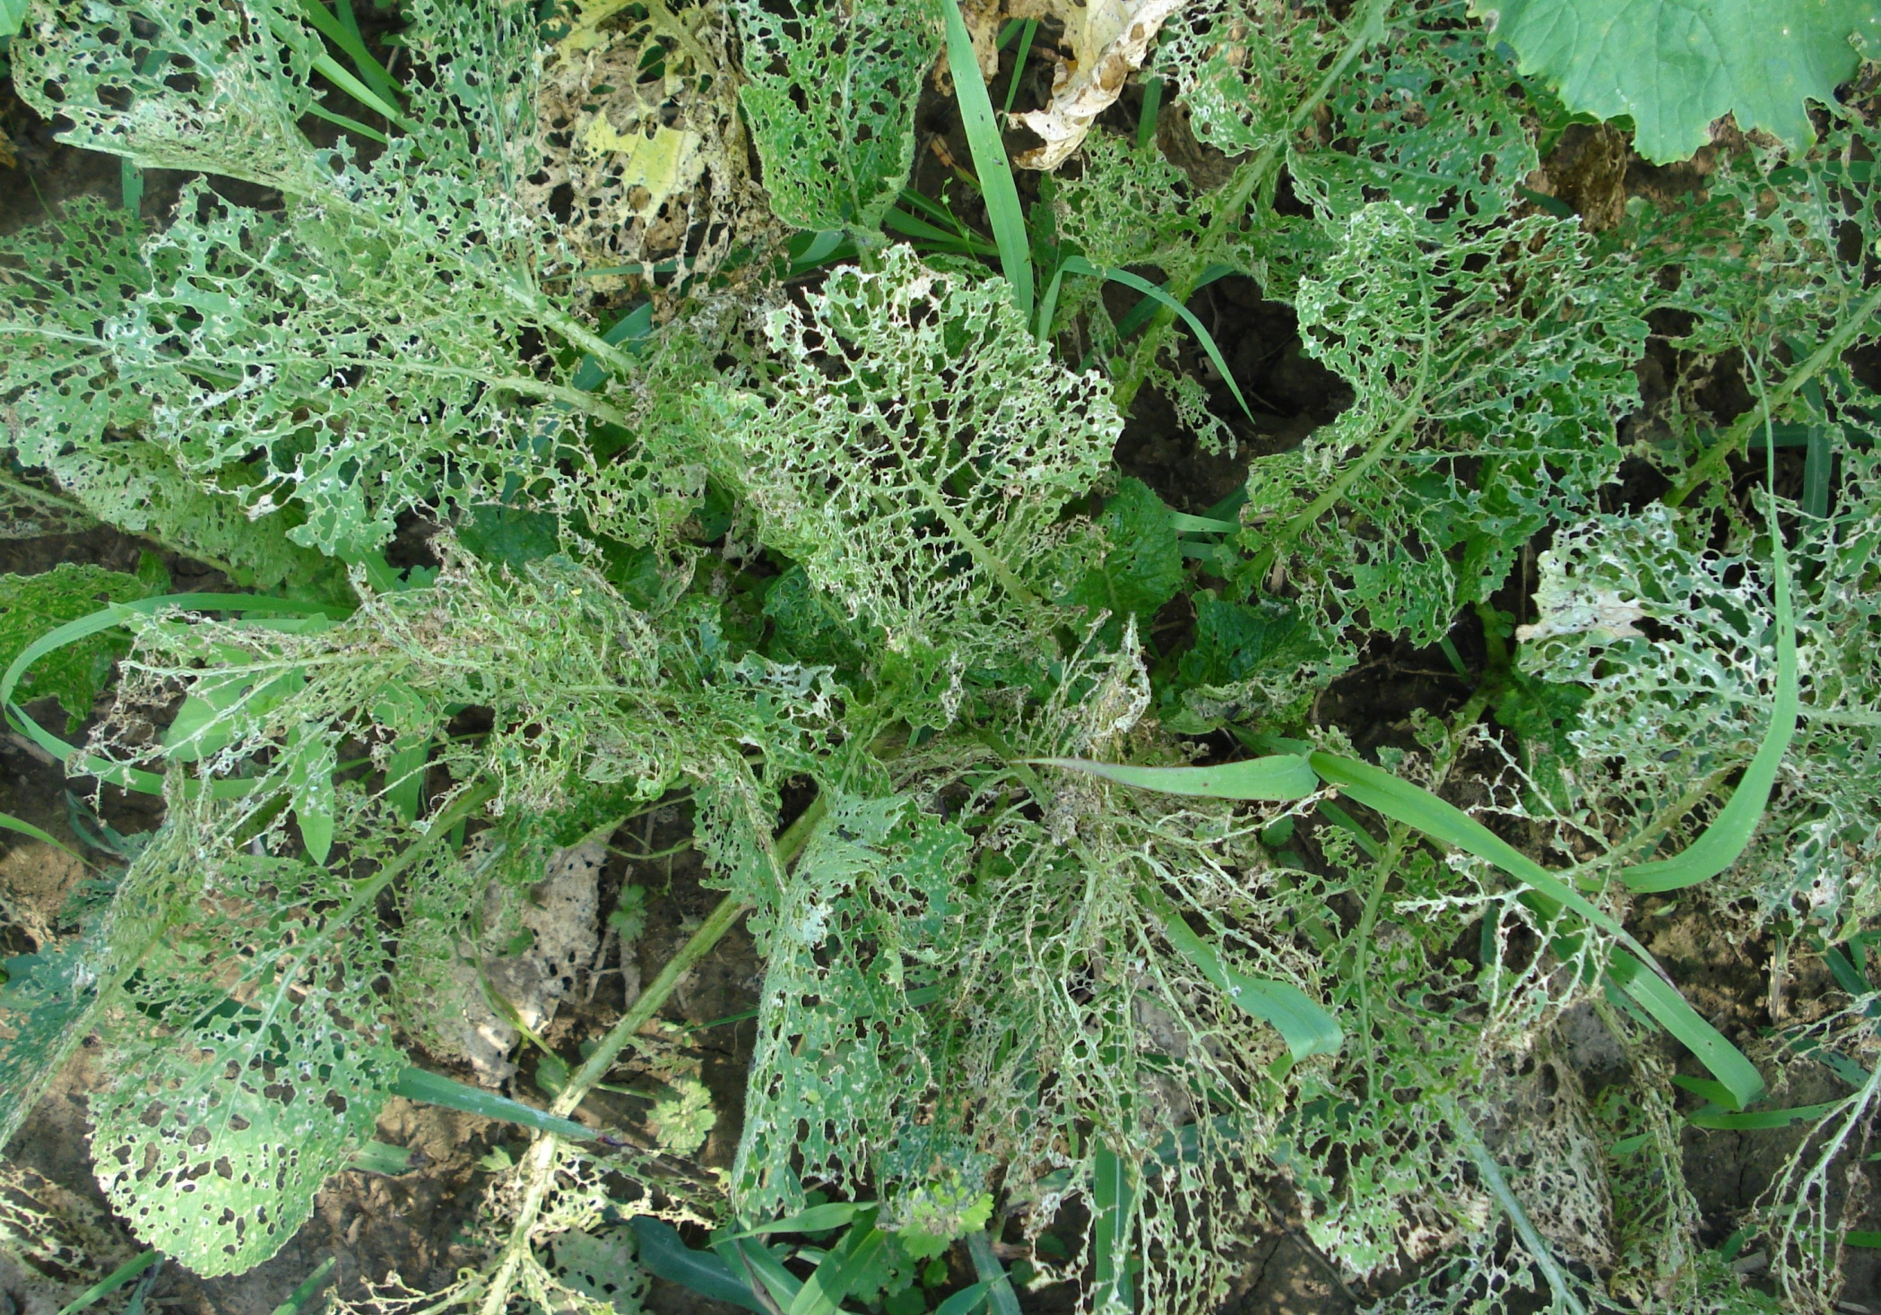
Turnip crop damaged by Yellowmargined leaf beetle

Slide 2
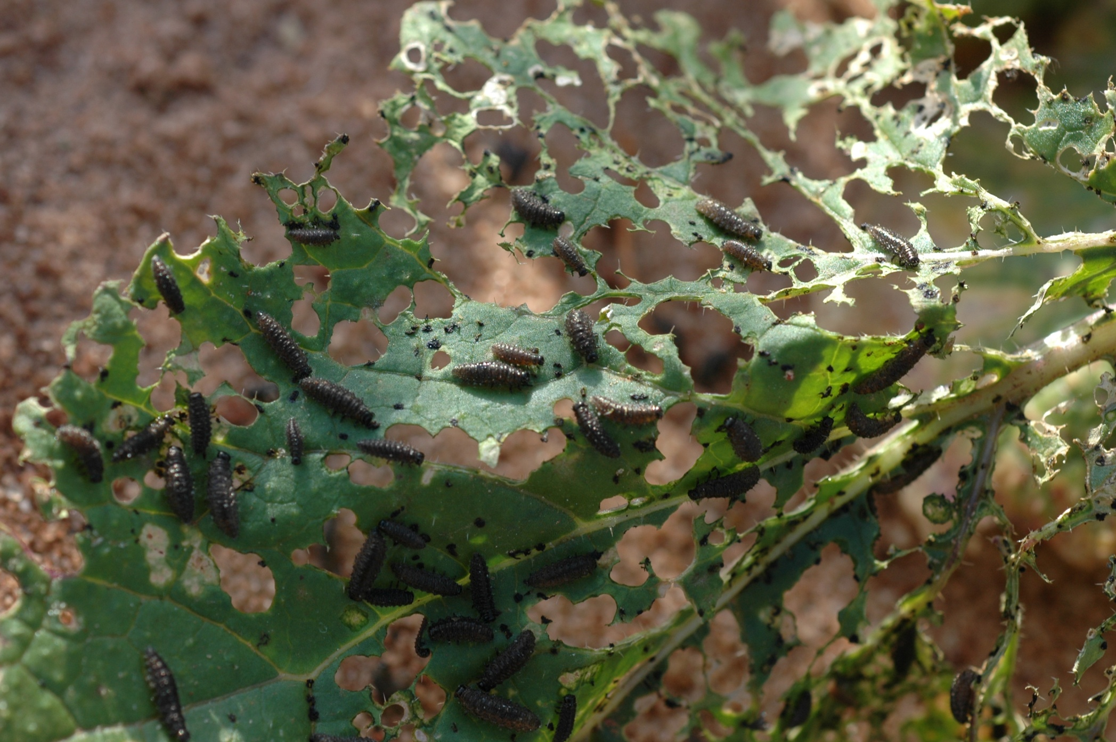
Larval defoliation of turnip leaf

Slide 3
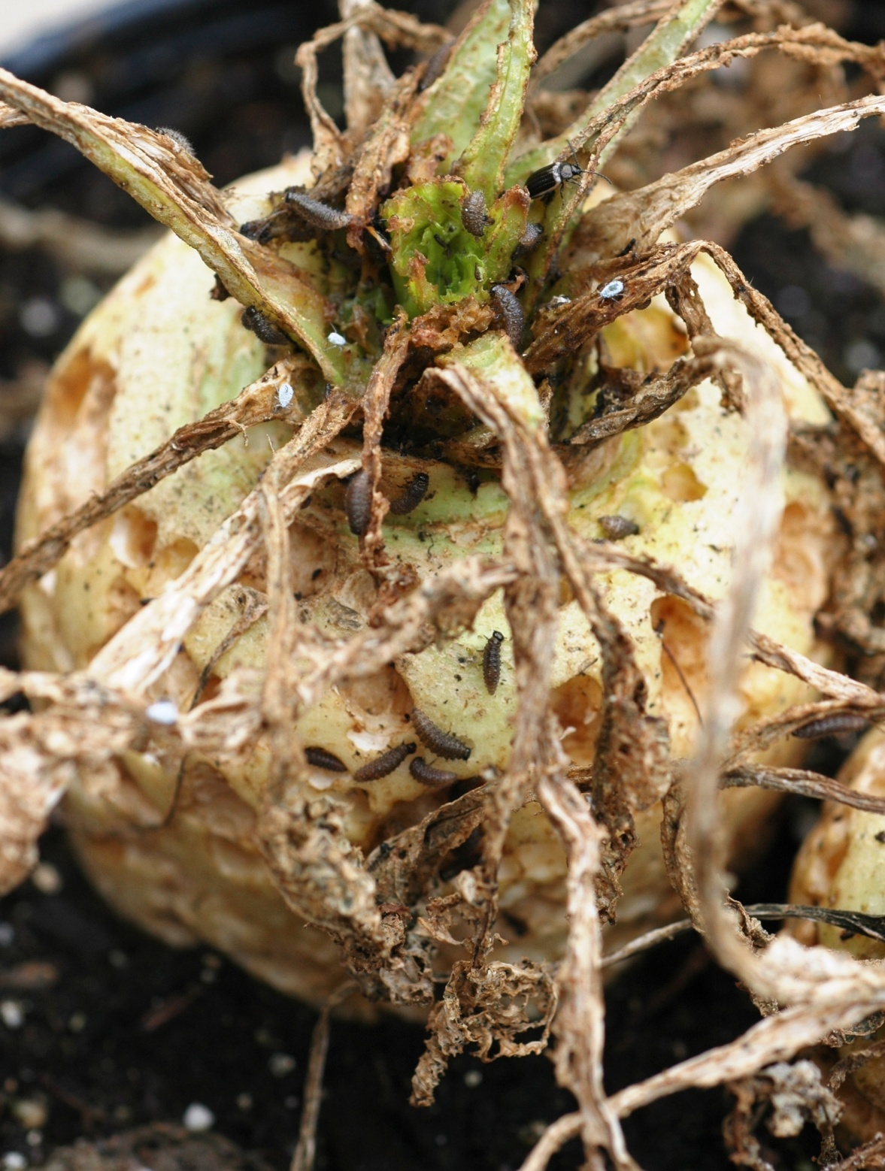
Turnip root damaged by yellowmargined leaf beetle larvae

Slide 4
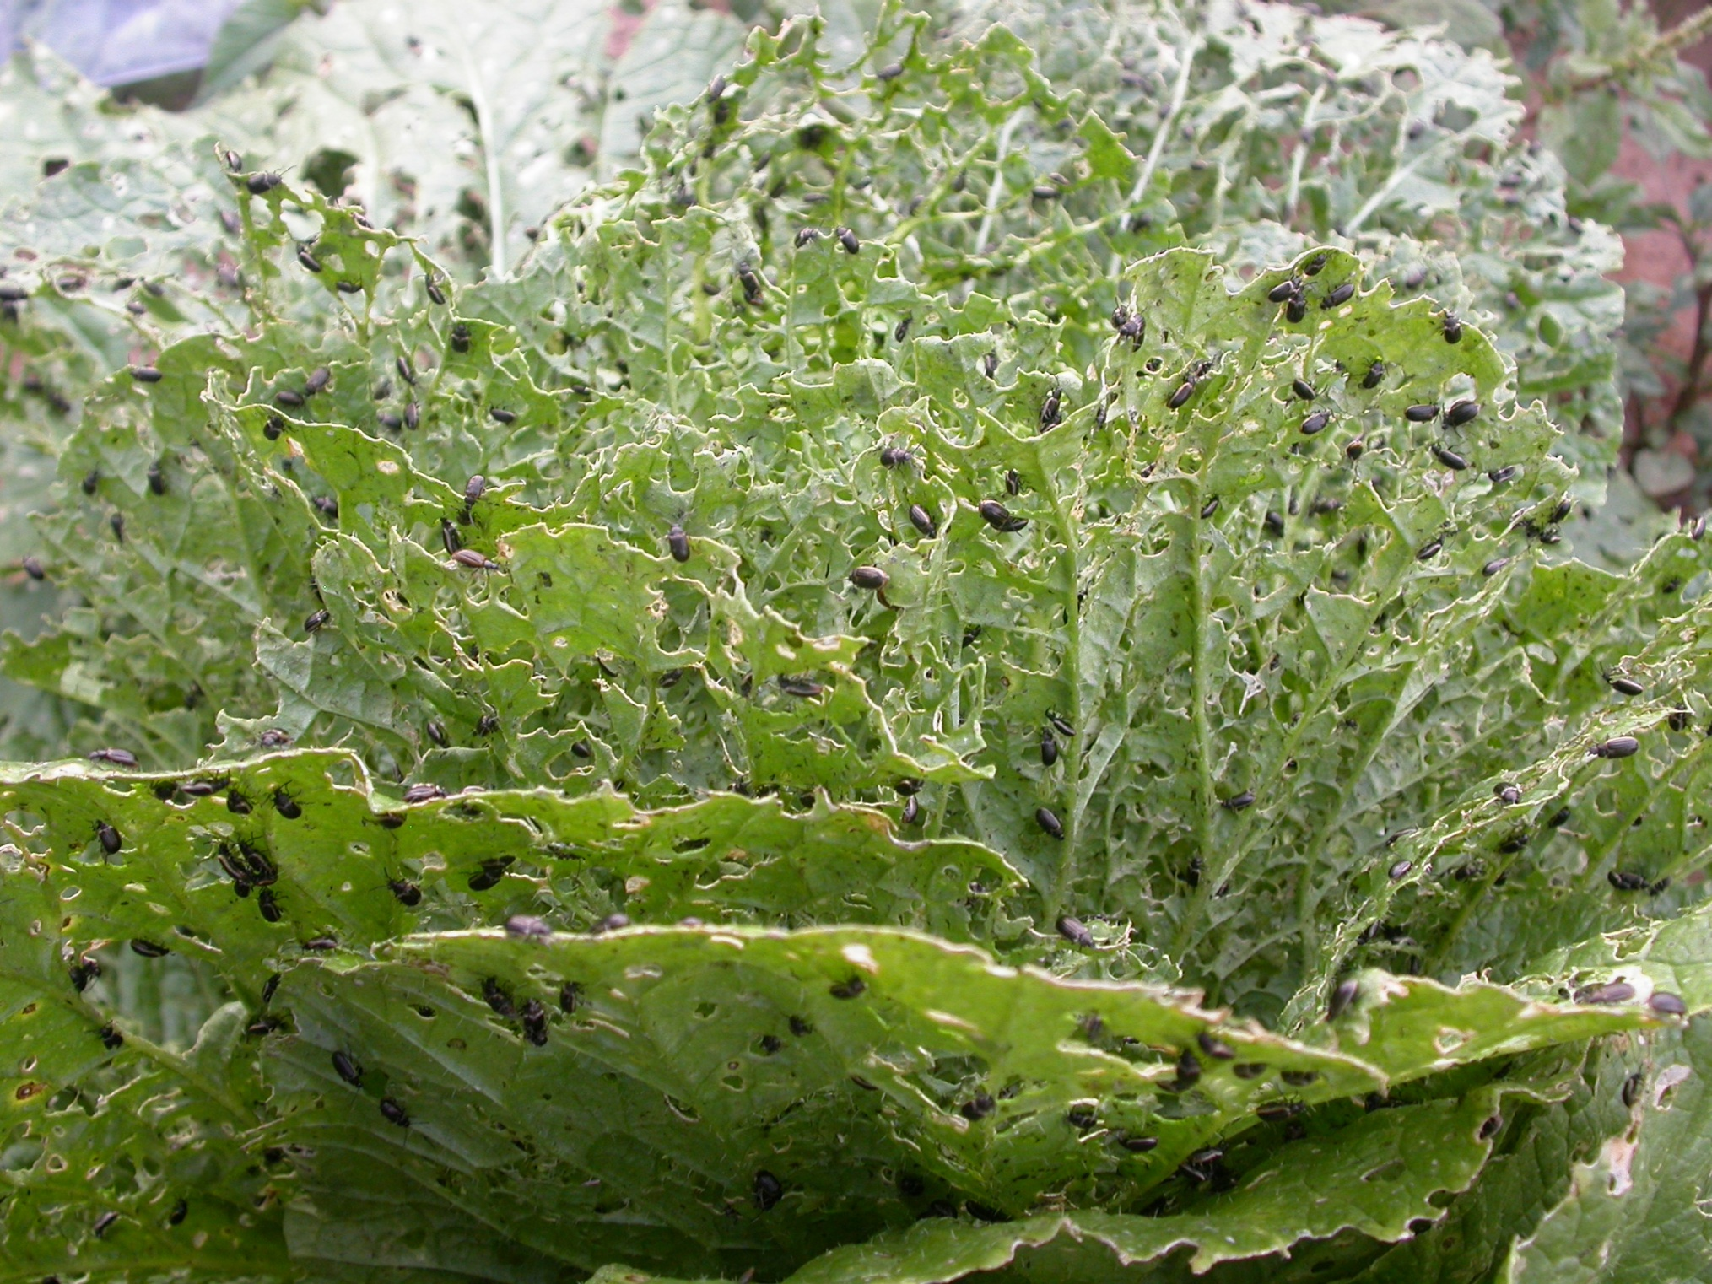
Mass attack of yellowmargined leaf beetle on napa cabbage

Slide 5
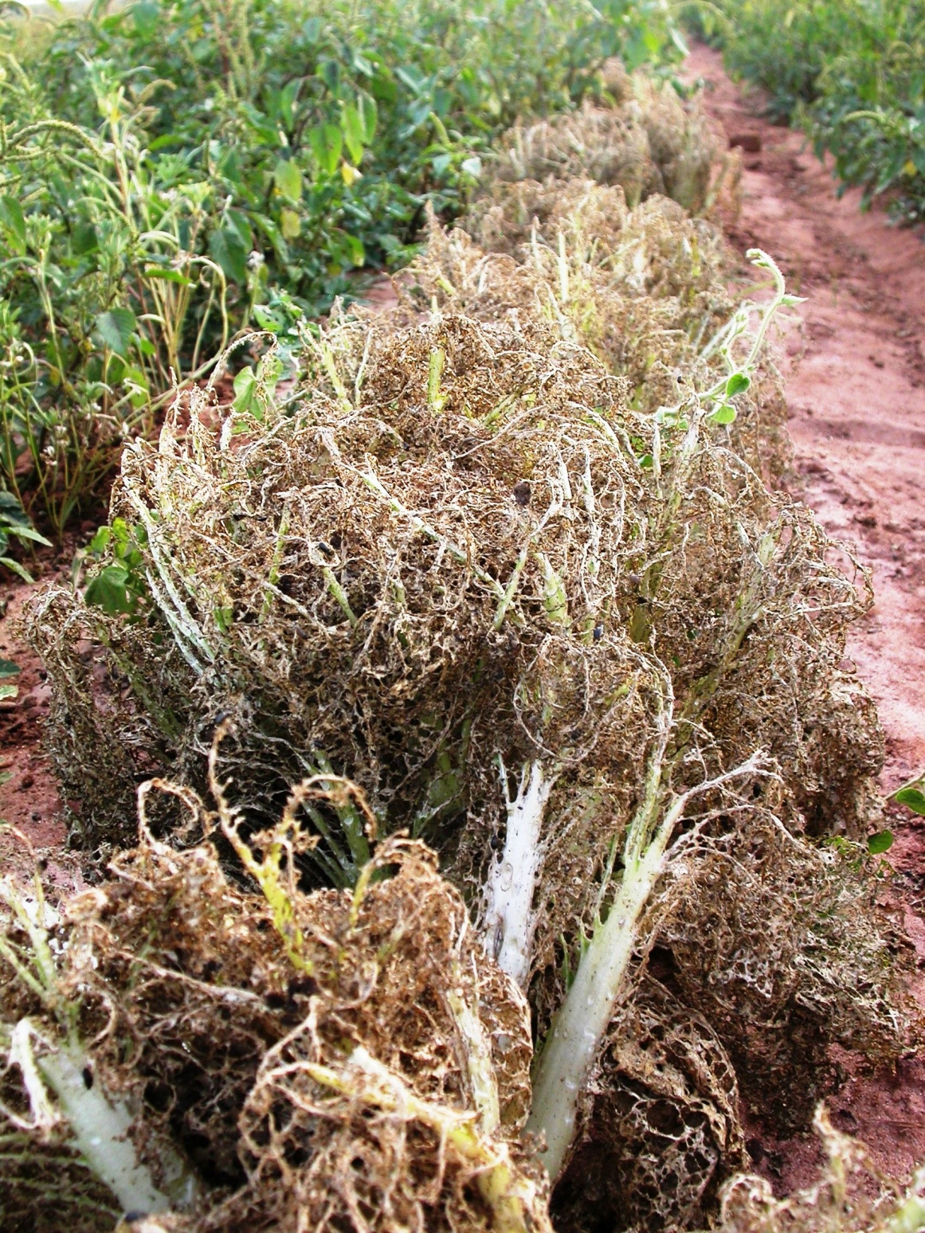
Organically managed napa cabbage field damaged by yellowmargined leaf beetle

